Slide 1
The Exploratory Data Analysis of Best Books Made into Movies
An analysis exploring key trends in book characteristics and their cinematic adaptations.
Presented By:
Course:
Trinadh Musunuri
ITC 510 - Software and Data Modeling
Himasri Valli Tatineni

Slide 2




Understanding Our Dataset: Scope and Preparation
Our Exploratory Data Analysis (EDA) focused on book-to-movie adaptations.
Scope
Objective
Analyzed approximately 52,000 unique books adapted for the screen.
Identified significant trends, correlations, and patterns in book and film metadata.
Preparation
Efficiency
Created features (e.g., 'publishYear', 'hasAward') and refined 'price' and 'pages' data types.
Removed redundant columns to optimize processing and focus the final dataset.

Slide 3
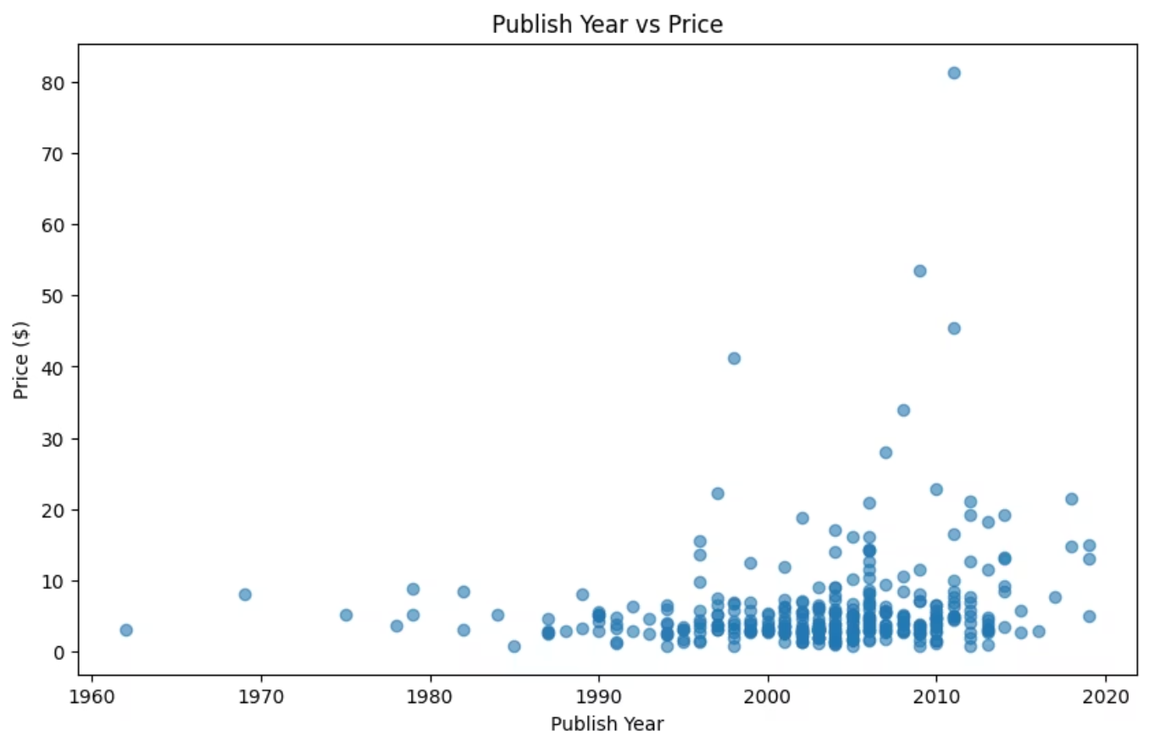
Investigating Price: Are Newer Books More Expensive?
We hypothesized newer books would be more expensive due to inflation, visualizing this with a scatter plot.
Hypothesis
Newer books are more expensive due to inflation and market trends.
Results: FALSE
No clear correlation between publication year and price. Variability is extensive across all periods.
Explanation
Price is driven by external market factors and book attributes, not publication year alone.

Slide 4
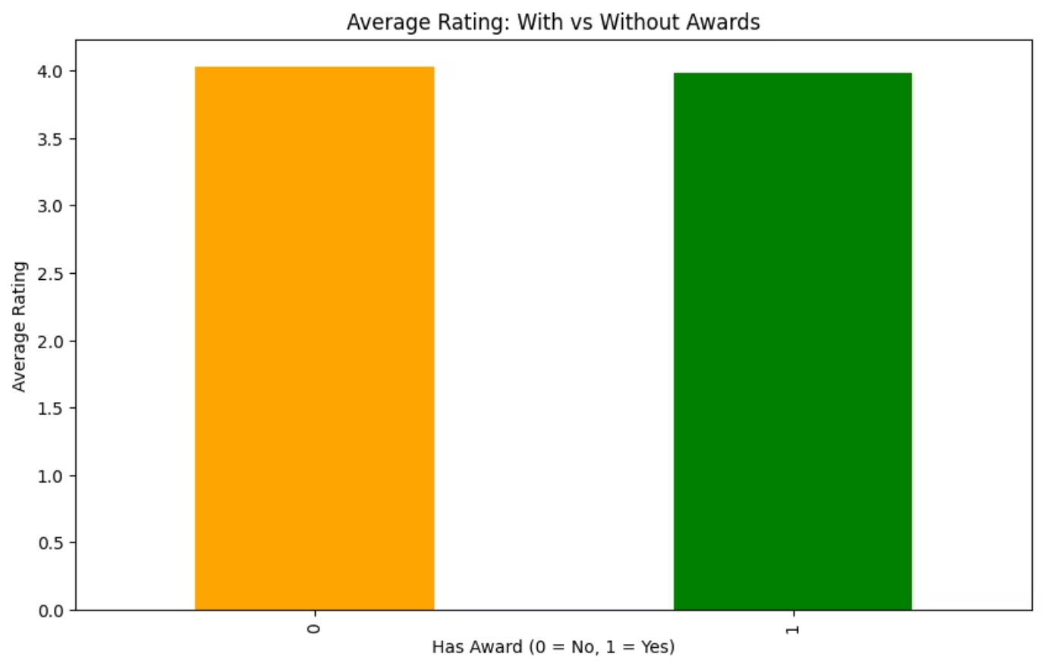
Critical vs. Popular Success: The Impact of Awards
Do awards predict popular success? We compared reader ratings for award-winning versus non-awarded books. Our hypothesis was false.
Hypothesis
Award-winning books will have higher reader ratings.
Results: FALSE
The box plot shows nearly identical average ratings. No significant difference in reader satisfaction.
Explanation
Critical acclaim does not guarantee higher average reader satisfaction. Many non-awarded books achieve similar reader success.

Slide 5
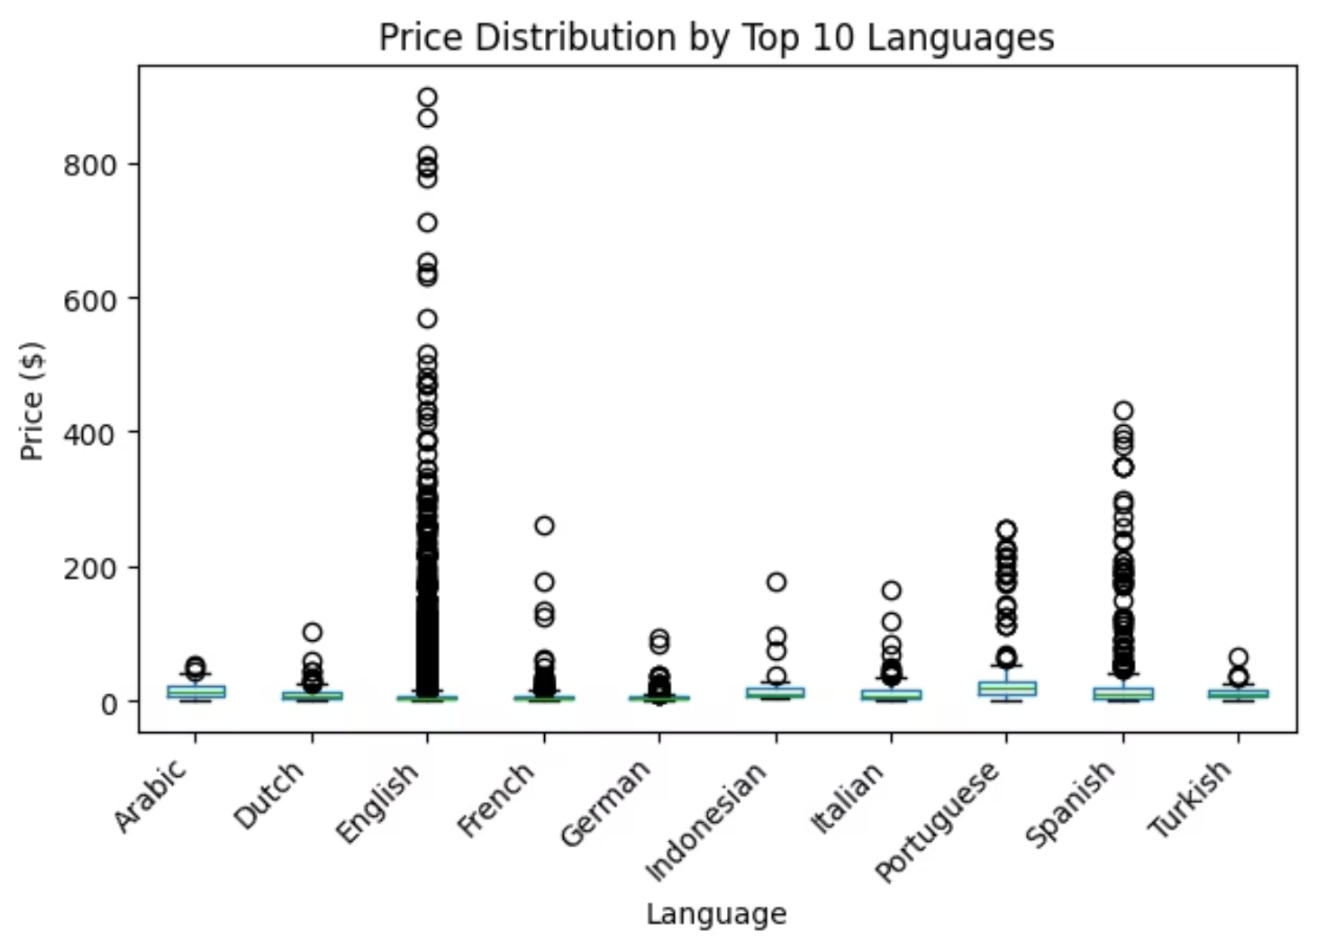
Exploring Language Diversity and Book Pricing
We investigated if book prices vary based on publication language across global markets.
Hypothesis
Book pricing patterns are similar across languages.
Results: FALSE
Significant price variations exist by language, with English books showing the largest price range.
Explanation
Differences are driven by production costs, target markets, economic factors, and translated editions.

Slide 6
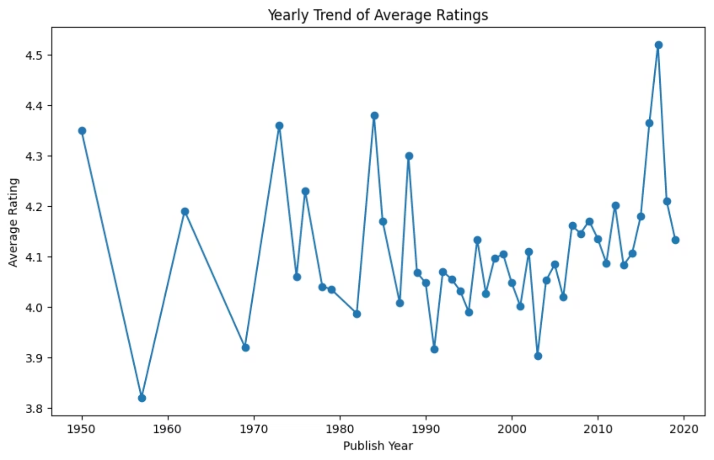
Have Reader Ratings Stood the Test of Time?
Hypothesis
Reader ratings should evolve with changing tastes.
Results: FALSE
Average ratings remained remarkably stable across decades.
Explanation
Good storytelling and engaging narratives transcend generational tastes, maintaining appreciation.

Slide 7



Key Findings from Our EDA
Our analysis of books adapted into movies revealed several key findings:
Critical vs. Popular Success
Literary awards don't guarantee higher reader ratings.
Global Pricing
Language and local markets heavily influence book prices.
Enduring Narratives
Reader tastes and ratings remain stable over decades.

Slide 8



Our Journey: Learnings, Questions, and Next Steps from the EDA
Our EDA revealed key findings and new questions.
What We Learned
Awards don't directly correlate with higher reader ratings; visual EDA was crucial.
Future Research
Future research will explore genre, digital impact, and audience demographics.
Thank You
Thank you for your time.

